Slide 1
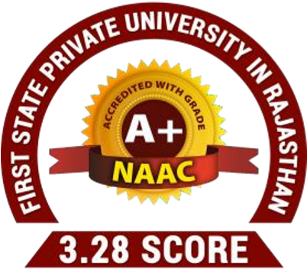



Course name: Electrical & Electronics System (EE1002)
B.TECH FIRST YEAR
ACADemic YEAR: 2023-2024
Course code : EE 1002
lecture series no : 01 (one)
Credits : 04
Mode of delivery : oFF line (Power point presentation)
Faculty :
Email-id :
PROPOSED DATE OF DELIVERY:

Slide 2
Session outcome
“Know the basics of the course and understand the basics of Electrical Systems in brief. ”

Slide 3
Assessment criteria’S
Assignment
quiz
mid term examination END TERM EXAMINATION

Slide 4

PROGRAM OUTCOMES MAPPING WITH CO1
[PO1]
Engineering Knowledge: Apply the knowledge of mathematics, science, engineering fundamentals, and an engineering specialization to the solution of complex engineering problems.

Slide 5
INTRODUCTION TO COURSE
&
BASIC OVERVIEW OF ELECTRICAL SYSTEMS
Lecture No. 1

Slide 6
Contents
Topic:
1. INTODUCTION TO COURSE
2. BASIC OVERVIEW OF ELECTRICAL SYSTEMS

Slide 7
1. COURSE OVERVIEW
Link for Course Handout

Slide 8
2. BASIC OVERVIEW OF ELECTRICAL SYSTEMS
2.1 Changeover from DC TO AC SYSTEM
Basic idea of generation Prior to the discovery of Faraday’s Laws of electromagnetic discussion, electrical power was available from batteries with limited voltage and current levels.
D.C generators were developed first to generate power in bulk. However, due to limitation of the D.C machine to generate voltage beyond few hundred volts, it was not economical to transmit large amount of power over a long distance. For a given amount of power, the current magnitude (I = P/V),
hence section of the copper conductor will be large. Thus generation, transmission and distribution of d.c power were restricted to area of few kilometer radius with no interconnections between generating plants.
Therefore, area specific generating stations along with its distribution networks had to be used.
In later half of eighties, in nineteenth century, an electrical power system with 3- phase, 50 Hz A.C generation, transmission and distribution networks came into existence
With adoption of a.c system, transmission of large power (MW) at higher transmission voltage become a reality. Level of voltage could be changed virtually to any other desired level with transformers – which was not impossible with D.C system.

Slide 9
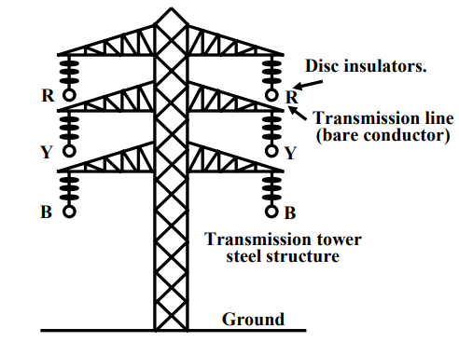
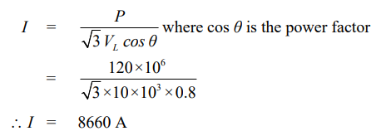
2.2 TRANSMISSION system
Consider a generating station producing 120 MW power and power is to be transmitted over a large distance.
Let the voltage generated (line to line) at the alternator be 10 kV.
To transmit 120 MW of power at 10 kV, current in the transmission line is calculated as,
If transmission voltage is selected 400 kV, current in the line would be only 261.5 A.
Cross sectional area of the transmission line (copper conductor) will now be much smaller compared to 10 kV transmission voltage.
Transmission Tower

Slide 10
The cost of conductor will be greatly reduced if power is transmitted at higher transmission voltage.
The use of higher voltage (hence lower current in the line) reduces voltage drop across transmission line and power transmission losses.
The magnitude of current decides the cost of copper, level of voltage decides the cost of insulators.
The idea is, in a spree to reduce the cost of copper one can not indefinitely increase the level of transmission voltage as cost of insulators will offset the reduction copper cost.
Standard transmission voltages used are 132 kV or 220 kV or 400 kV or 765 kV depending upon how long the transmission lines are.
At generating station (sending end) step up transformer is installed to raise the transmission voltage to desired level as specified above.
At the load centers (receiving end), with step down transformer, voltage level should be brought down at suitable values for supplying different types of consumers.

Slide 11
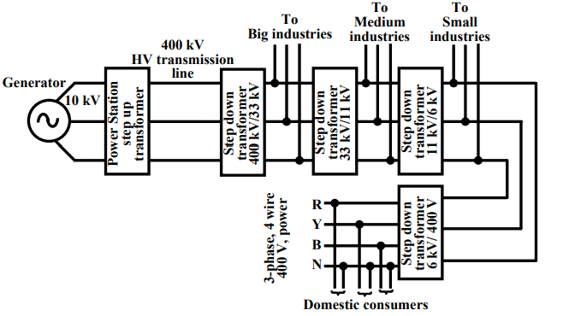
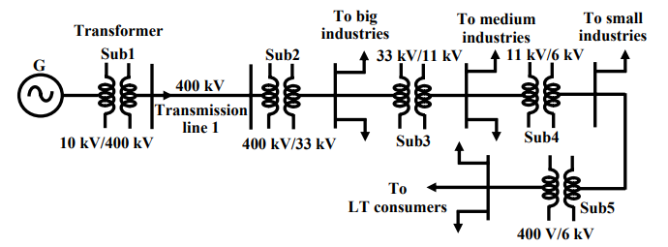
Typical Voltage Levels in Power system
Single Line Representation of Power System

Slide 12
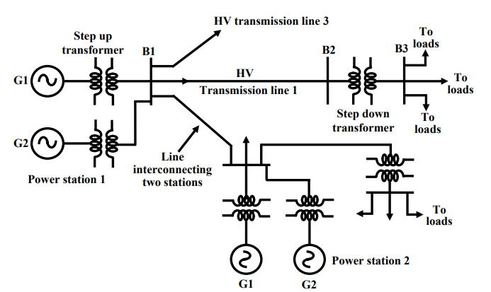
Typical Layout of an interconnected Power System

Slide 13
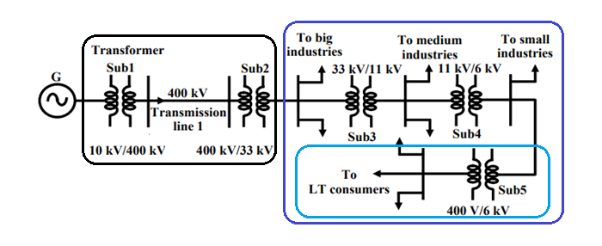
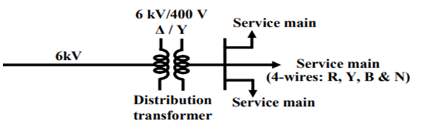
2.3 Distribution system
Transmission System
Power receive at a 11 kV (or 33 kV )substation is first stepped down to 6 kV and with the help of under ground cables (called feeder lines), power flow is directed to different directions of the city. At the last level, step down transformers are used to step down the voltage form 6 kV to 400 V.
These transformers are called distribution transformers with 400 V, star connected secondary.
N is called the neutral and taken out from the common point of star connected secondary. Voltage between any two phases (i.e., R-Y, Y-B and B-R) is 400 V and between any phase and neutral is 230 V.
Distribution System

